Slide 1
τ
Rick McGeer
Distinguished Technologist
HP Enterprise Services

Slide 2
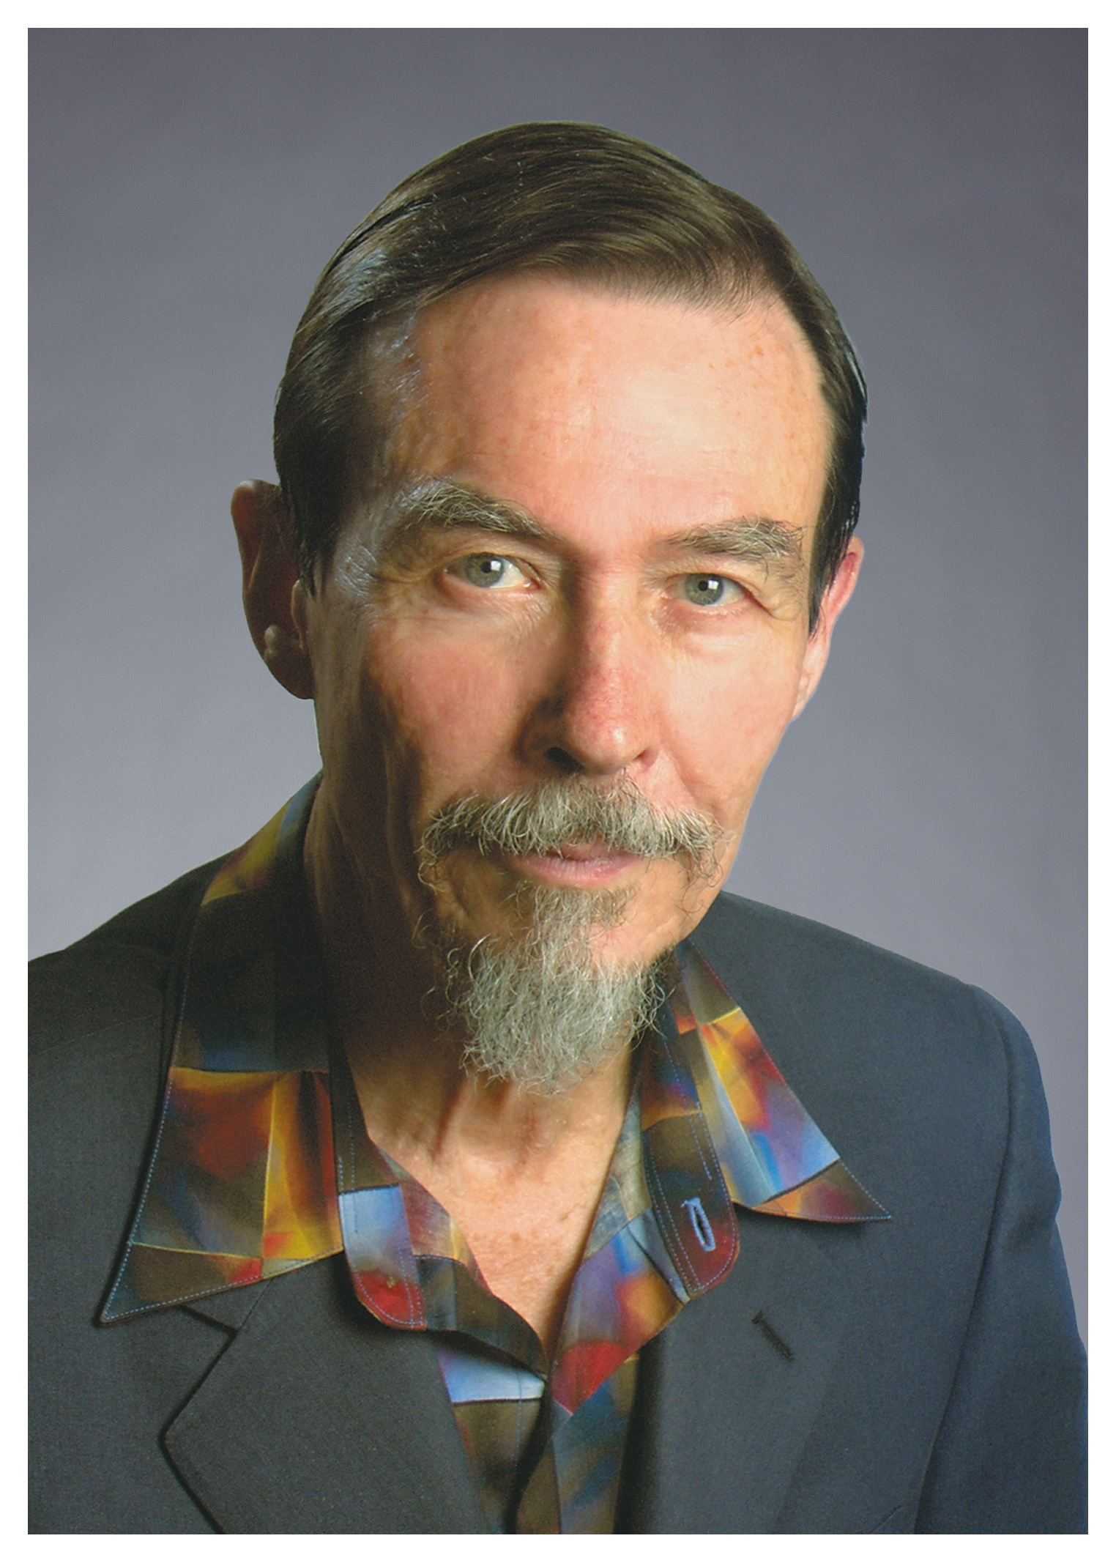
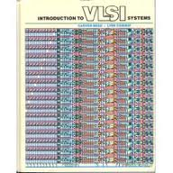
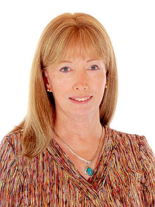
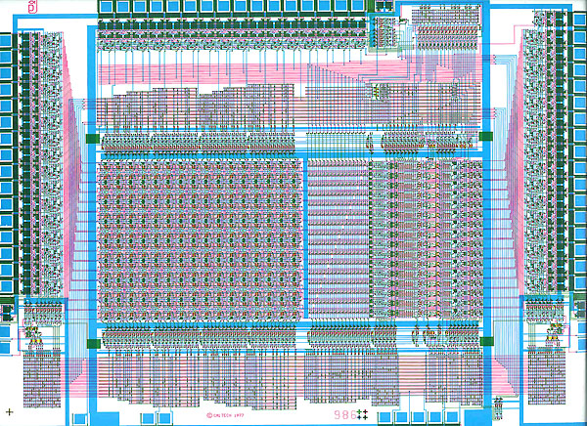
Back Before The Earth Cooled…
The Great Era of Academic VLSI
Started by Mead & Conway

Slide 3
The Mead & Conway Revolution
Graduate class at Caltech, 1979
VLSI Design
  Simplified rules (synchronous design, Manhattan geometries, “lambda” (scalable) design rules)
Fab through DARPA MOSIS program
  Industrial and academic fabs made time available for graduate student projects
Every graduate student could make his own chip!

Slide 4
Three Major Revolutions
Custom processors (mostly a terrible idea)
Application-Specific Integrated Circuits
  Used primarily for Digital Signal Processing, Routing
  Some printers (not anymore)
  Displays, high-end graphics, etc
Computer-Aided Design (no way could you design these by hand, contrary to Nick Tredennick)

Slide 5
Computer-Aided Design
Grew up because graphics workstations were coming up at the same time as VLSI
Could layout circuits on a screen, not as regoliths on a floor(!)
Started small and simple
  Layout editors, design-rule checkers, switch-level simulators,
Got more sophisticated
  Timing Analyzers
Did the design for you
  Compactors, Channel Routers, Global Routers, Place and Route Systems, Logic Synthesis Systems, Multi-Level Synthesis Systems, Sequential (FSM) Synthesis, High-Level synthesis (bad idea), Silicon compilers (worked for DSPs, routing chips, not much else)….

Slide 6
CAD Became the Big Academic News
Great for Computer Scientists
  Optimization problems were almost all NP-Complete or worse, but heuristics worked well
Not much equipment needed (workstation)
Big problem was access to designers…
  But academic chip-building efforts helped a lot
Graduate Students and faculty founded companies, often while still in school!
  SDA, ECAD (merged to form Cadence)
  Optimal Solutions (Synopsys)
  Magma…
  Etc…

Slide 7
Basic Design Paradigm
Logic
Latches
Latches
How long does it take the logic to compute?

Slide 8
Timing Analysis
Became a huge problem
Fundamental Problems: Modeling and Scale
Modeling
  Exact Solution required analysis of PDEs
    Unscalable, unused
  Good approximation was solution of ODE’s by forward-difference (Euler) method
    Only useful for small subcircuits, e.g., adder carry chain
  Modeling gate as ideal block with fixed delay
    Weak approximation, but could use it for computation!

Slide 9
Many Early Analyzers
TV (Norm Jouppi, Stanford)
Crystal (John Ousterhout, Berkeley)
Super-Crystal (Antony Ng, Berkeley)
All modeled circuits as ideal graphs of nodes
  Went from collection of circuits to graphs of gates, with delay
  Most of the effort went into recognizing directed graph of gates from undirected graph of transistors
  Circuit became an acyclic graph of gates
  Solvable In linear time!

Slide 10
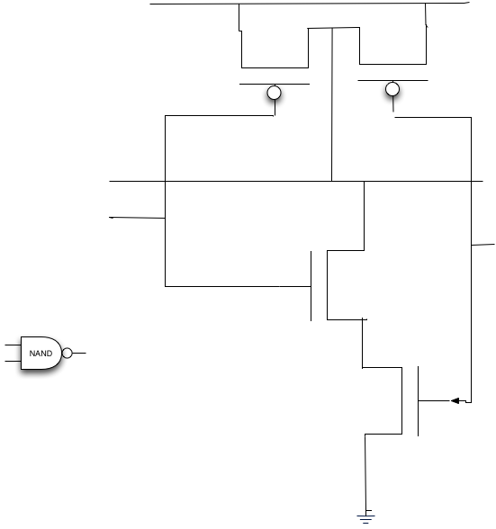

Slide 11
But…
Simple graph of gates didn’t cut it!
Ignored interaction between gates
Led to wrong answers…
Carry-bypass adder had delay root(n)
Timing Analyzers said it had delay root(n) + n!
  “False Path Problem”
Oops…

Slide 12
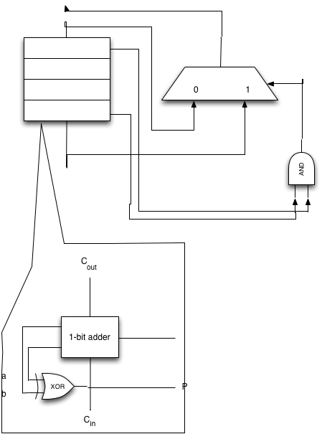

Slide 13
Solution
We needed to consider function and timing at the same time
New generation of timing analyzers (still sold today!)
General idea:
  Gate was considered as a transducer that computed a function over time
  Transitioned from previous value to “X” (undefined) to final value
  Computed characteristic functions (input vectors) which set gate to (0, 1, X) at time t
  Characteristics of gate were computed from characteristics of inputs at previous times
  Delay of circuit was when characteristic for X on output went to 0 and stayed there

Slide 14
Discovered in Late Eighties
And immediately led to suspicion: by considering function and timing together, what else could we discover?
Led to τ workshop (first workshop, 1989)
First general chair (me)
First program chair (Bob Brayton, UC Berkeley
First venue (UBC)
Approximately 40 attendees

Slide 15
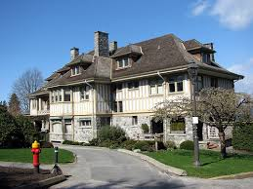
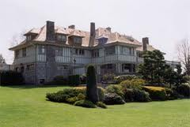
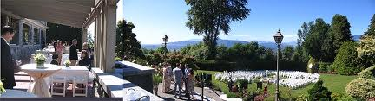
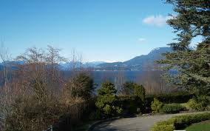

Slide 16
Early Topics Covered
Delay-fault test
“Generalized Bypass Transform” (improving speeds by making paths false, not short)
Sequential Circuit optimizations for performance
  “Retiming” (moving latches to optimize paths)
  “Negative retiming” (Sharad Malik: removing all latches from circuit, optimizing, re-inserting)
  “Negative retiming and pipeline optimization” (leaving “negative latches” in as pipeline stages…)

Slide 17
τ in the Future
What Does t have to teach us beyond circuit design?
More precisely, what have we learned that is applicable to computer science generally?
Well, start with making computer science a genuine science…

Slide 18
Science vs. Computer Science
What is science?
  Construction of models consistent with observation that predict the outcomes of future observations
What is Computer Science
  Not that
  Construction of devices, algorithms, and systems to accomplish given tasks
  Worst-case analysis of algorithms

Slide 19
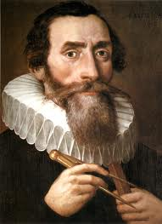
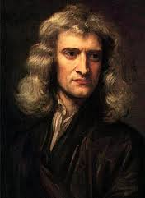
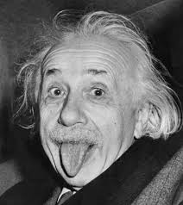
Science…
Three Laws of Planetary Motion (Just fit curves to observations)
Inverse-square universal gravitation (“explains” Kepler’s Laws)
Gravitation is a geometric effect of mass/energy on spacetime (symmetry, explains anomalies)

Slide 20
Timing Analysis Comes Closest!
Consider the papers at this τ
Common theme is the following
  Derive a model at a low level of abstraction (physical principles, e.g.)
  Experimentally characterize parameters (numerical experiments, physical observation)
  Derive higher-level model consistent with lower-level model
  Use this to solve larger-scale problems
  Recalibrate…
  Carry to higher-levels of abstraction

Slide 21
Timing Analysis Born of a Revolution of Scale…
VLSI era: We could no longer (Tredennick to the contrary) design chips by hand
  Needed automated tools
  Tools needed serious, real science to work properly
Some things could be done without data (P&R, Synthesis, compaction…) but timing needed data-driven models

Slide 22
Another Revolution of Scale is Brewing…
Loosely (and tightly) parallel computing, on-chip and off
On-chip: Clock speeds have flattened; Moore’s Curve now dependent on parallelism
  Means: we need to go to massive multithreaded programming (CUDA?)
Off-chip: Combination of massive clusters and massive demand
  A Yahoo! “clique” of servers is 20,000 servers! (approx 200,000 cores!)
  Societal-scale services

Slide 23
Do We Need Science in These Areas?
Hoo, boy, yes!
Multicore/multithreaded programming
  Much like asynchronous logic design in the late 1970’s
  Huge problems (bad updates, deadlocks) in multithreaded programs
  Needs something like the synchronous discipline (e.g., SMV, V++, Esterel, Lustre)
  But this will lead to timing analysis issues…slowest thread will dominate

Slide 24
New Stuff (Cont)
Hadoop/MapReduce programming and scheduling
  Again, need to characterize behavior of Map jobs (reduce jobs, too, but not as important)
  Exact models infeasible (dependent on cache behavior, etc)
  Approximate Models can make a huge difference

Slide 25
Societal-Scale Systems
Large Internet firms have millions of simultaneous connections and tight time deadlines
  Ex: Facebook must return page to user within 150 ms
Problem: Emergent behavior at scale
  Small (unnoticeable) problems become massive with millions of users
  Ex: Twitter infrastructure crashed at 1m connected users (RoR infrastructure couldn’t take it)
  Ex: Six Flickr developers took down Flickr
Crying need:
  Calibrated models which predict behavior at large scale

Slide 26
Overall
The era of loosely-coupled, highly-parallel, massive-scale programming is a revolution like the VLSI revolution of the 1980’s
Programming today resembles cottage-industry hand-done stuff like LSI in the seventies
We will need the disciplined, scientific approach that made VLSI-scale chips possible
New frontiers for this community

Slide 27
But Do We Have Another MOSIS?
Oh, yes…GENI
Grew out of an Intel/HP/Princeton/Berkeley Initiative – PlanetLab
Worldwide/Continentwide cloud for experimenters and students

Slide 28
GENI
Ubiquitous cloud with deeply-programmable networking
Ubiquitous Cloud
  Abstracted API that can be implemented by any popular cluster manager (Slice Federation Architecture)
  Designed for federation
  Certificate-based access control (No need for single sign-on, common AUP)
  Implementations with fine and deep control of resources (ProtoGENI)
Deeply Programmable Network
  Open Flow native
  Layer 2 backbone

Slide 29
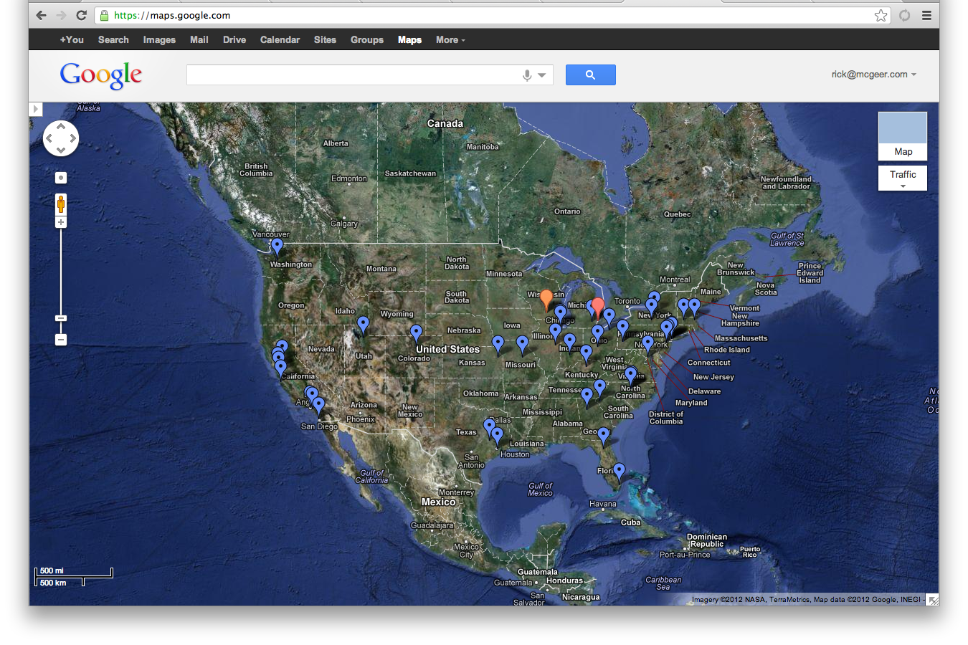
GENI Mesoscale

Slide 30
Conclusions
VLSI Bred a Revolution
Added science to chips and design
τ was an outgrowth of that
A new revolution is brewing…
Time for a τ in systems?

