Slide 1
Construction Of A Timing-Driven Variation-Aware Global Router With Concurrent Multi-Net
Congestion Optimization
Radhamanjari Samanta*, Soumyendu Raha* and Adil I. Erzin#
* Supercomputer Education and Research Centre, Indian Institute of Science, Bangalore, India
# Sobolev Institute of Mathematics, Siberian Branch, Russian Academy of Sciences, Novosibirsk, Russia

Slide 2
Outline
Introduction
Algorithm MAD(Modified Algorithm Dijkstra)
Experimental results on IBM Benchmark
Statistical (Variation Aware) MAD
Deterministic vs Statistical MAD
Conclusion

Slide 3
ALGORITHM MAD
Constructs a set of Steiner trees for each net in global graph, such that
  capacities of the edges are not violated (congestion aware).
  delays in primary outputs are upper bounded by the given bounds (timing driven).
Input of algorithm:
  Logical network as a set of nets and primary inputs with Arrival Time(AT)s and primary outputs with Required Time(RT)s;
  Number of layers;
  Specific resistance and capacitance and maximum number of channels
  Qij (capacity of corresponding global edge) in each layer;
  Resistances and capacitances of vias

Slide 4
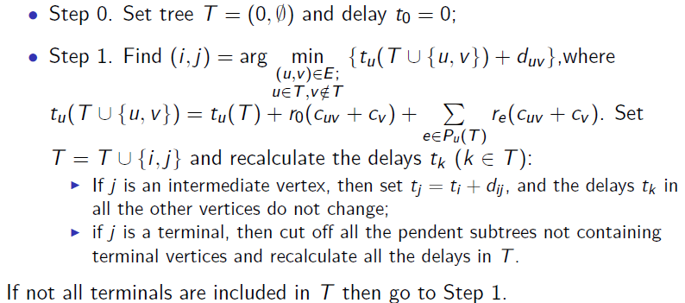
Steps of Algorithm MAD

Slide 5
An Example execution of MAD

Slide 17
Congestion-aware tree selection for each net
IMAD(Iterative MAD) is used to build a set of timing-driven
Steiner trees for each net.
For each net, a tree is chosen using a gradient algorithm.
The tree is chosen s.t. the minimum residual (current) capacity of global edges is maximum.
This is a concurrent approach considering all the trees of all the nets simultaneously.

Slide 18
Max Overflow with and without Gradient

Slide 19
Total Overflow with and without Gradient

Slide 20
Variation Aware MAD
Process variation becomes prominent in the nano regime.
As a result, delay is no more deterministic.
Derive equivalent statistical MAD by considering process dependent parameters (resistance, capacitance) as Gaussian random variables.
Random variable Mean = deterministic value and standard deviation= 7% of their respective mean.
Mean of 1000 Deterministic Monte Carlo simulations(varied randomly in the range of μ±3σ is calculated.
Run the statistical router only once.
Means(Deterministic and statistical) are compared.

Slide 21
Steps of Variation aware MAD
At each step, calculate the minimum distribution of two edges(among all candidate edges).
Find the K-L divergence of minimum distribution from both the distributions.
Choose the edge which has less divergence from min distribution.
In this way, Find the min-delay edge to be added to the tree.
Continue until all sinks are added to the tree.

Slide 22
Exact Distribution of Minimum of two Gaussian R.V.
Let X₁(μ₁, σ₁²), X₂(μ₂, σ₂²) denote two Gaussian random variables. If the
distribution of X₁ and X₂ are non-overlapping, 3σ pruning condition is set.
If μ₁ + 3σ₁ < μ₂ − 3σ₂
=> μ₁ − μ₂ < −3(σ₁ + σ₂)
=> |μ₁ − μ₂| > 3(σ₁ + σ₂)
then, X₁ will be the minimum.

Slide 23
When the distribution of X₁ and X₂ are overlapping,
X = min(X₁,X₂) will be a different distribution.

Slide 24
Kullback-Leibler Divergence
Finds the nonsymmetric measure of the difference between two probability distributions P and Q.
If P and Q are given probability distributions of a continuous random variable and the densities of P and Q are p and q respectively then, K-L divergence of Q from P is
Symmetrised divergence :

Slide 25
Kullback-Leibler Divergence

Slide 26
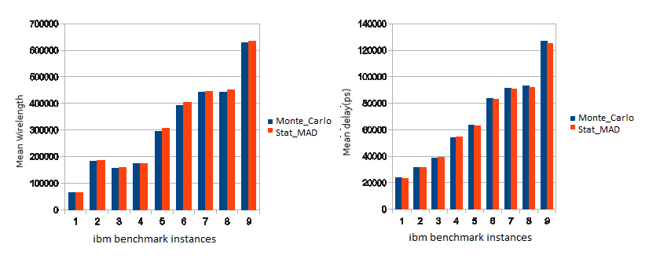
Deterministic Monte Carlo Vs Statistical MAD(wl & delay)

Slide 27
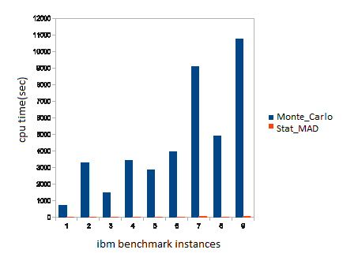
Deterministic Monte Carlo Vs Statistical MAD(ovfl & runtime)

Slide 28
Conclusion
Proposed a timing-driven congestion-aware and variation- aware Global Router.
Our router has accurate and fast solution on ibm
benchmarks.
Monte Carlo Simulation takes much longer time compared to the time taken by our statistical router.
Statistical Router is more efficient to use than so many Deterministic Monte Carlo Simulations to predict results with process variation.

Slide 29
THANK YOU
Contact: samanta@ssl.serc.iisc.in

