Slide 1

EDA for Mixed Signal Design
Chirayu Amin
Design and Technology Solutions
Intel Corporation
March 12, 2015
Acknowledgements
Chandramouli Kashyap, Scott Little, Soner Yaldiz

Slide 2
Timing Analysis in a Mixed Signal World
Performance Analysis in a Mixed Signal World

Slide 3
Mixed Signal Landscape
Ingredients
PLL: clk_{out} frequency = N * clk_{in} frequency
DLL: clk_{out} phase = clk_{in} phase + delay
PI: clk_{out} phase = w1*clk1_{in} phase + w2*clk2_{in} phase
PLL
DLL
PI
Amplifiers: v_{out} = A*v_{in}
vp_{out}-vn_{out} = A*(vp_{in}-vn_{in})
PA
VGA
LNA
Voltage Regulator: v_{out} = constant requested voltage
Equalizers: v_{out}(t) = h(t)∗v_{in}(t)
v_{out}[n] = h[n]∗v_{in}[n]
Slicer: v_{out} = 1 if v_{in} > v_{th}, 0 otherwise
Mixer: v_{out} freqs. = v1_{in} freqs. ± v2_{in} freqs.
ADC: vout[N:0] = digitized version of v_{in}a
DAC: v_{out} = function of digital v_{in}[N:0]
Bandgap reference: v_{out} = constant fixed voltage
VR
CTLE
DFE
Slicer
Mixer
ADC
DAC
BandgapRef.
Mixed Signal Design

Slide 4
Mixed Signal Landscape
Ingredients
Systems
PLL
DLL
PI
DDR I/O
HSIO (USB)
TX
RX
TX
RX
PA
VGA
LNA
Display I/O
RFIO
TX
RX
VR
CTLE
DFE
Slicer
Power Delivery Network
Sensors
Mixer
ADC
DAC
BandgapRef.
Clocking Networks
Mixed Signal Design
System Integration

Slide 5
Mixed Signal Design Wish List
Speed and Accuracy (1 hour, 1 day)
Deal with reality
  Corners, variability, non-idealities, parameterization
  Production RTL, UVM/OVM, UPF
Startup and tuning checks
Polarity and connectivity checks
Flexibility for accuracy/speed tradeoffs
  Slow spice, fast spice, no spice
GUI instead of typing in a text editor

Slide 6
Digital-Analog-Digital Timing
How do you characterize analog delays?
Digital FSM
Analog Circuit
feedback
on code
What if delays depends on multiple different inputs switching in time-staggered manner?
control code
clock
clock
control code
b101
b100
b011
b100
feedback
time

Slide 7
Timing for analog
PLL Feedback Divider
Frequency Divider
VCO Output Clock
Feedback Clock
Wide frequency range
Clock
What targets to use for timing analysis?

Slide 8
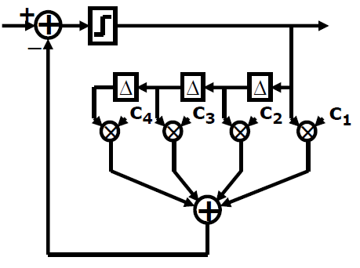
Timing within analog
Decision Feedback Equalizer
Do we have a critical path?

Slide 9

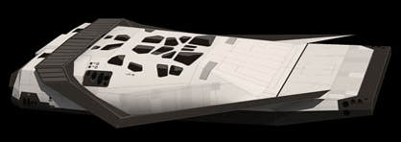
Speed and Accuracy
Analog Simulator
Digital Simulator
Slow Spice Fast Spice No Spice
Accurate and Slow
Approximate and Fast
How to stay in “No Spice” land and still achieve “Slow Spice” accuracy?
Behavioral
Model
Spaceship Image Credit
Wormhole Image Credit

Slide 10
EDA for Behavioral Modeling
Library of SV, VAMS, Verilog-A models
  Parameterizable
Parameter extraction
  From pre/post-lay netlists
Pin compatible models for drop-in spice-replacement
  N-dimensional LUTs
CTLE
DFE
CTLE
1
CTLE
2
Similar to
cell library characterization
CTLE
2

Slide 11
Stability and Optimality
Multiple control loops and tuning knobs
What algorithm to use for calibration?
  Will the design have stability problems?
  Will the tuning algorithm converge to the optimal solution for all knobs?
  What are we leaving on the table?
PLL
DLL
PI
CTLE
VGA
Slicer
CDR
Digital
FSMs
DFE

Slide 12
Backup

Slide 13
Using Production RTL
Do analog DEs understand RTL testbenches (OVM/UVM)?
What about unified power format?
  Analog design tools are not up to speed
What about compilation process?
  Includes
  Defines
  Arguments
  Compilation order

