Slide 1
Constraints evolution
Physical-Simulation-STA
Yaron Kretchmer
Engineering Director

Slide 2
Agenda
1
2
3
4
5
Background
1st Gen
2nd Gen
3rd Gen
Discussion

Slide 3
Background
A long time ago in a semiconductor company far, far away…
A long time ago in a semiconductor company far, far away…
In other words, this did not happen at Qualcomm…
There was a block called “QB”.
  It contained a large number of high-speed signals being driven over long distances.
This block evolved from
  A hand-drawn full-custom implementation with no timing verification…
  Through an automated full-custom implementation with dynamic timing verification through simulation…
  To P&R with timing constraints and validation through static timing analysis
In this presentation
  I’ll describe the “why’s” and “how’s” of the block’s evolution

Slide 4

1st Gen
Source
Constraints
  Signal Width, Spacing, Shielding
Implementation
  Manual full custom layout
Verification
  Physical length verification
Effort
  Baseline effort = 1*EF
Size
  Baseline size = 1*SZ

Slide 5
1st Gen pros/cons, drivers for migration
Source
Verification wasn’t exhaustive for all signals
Verification was done through home-grown scripts run on post-layout database
  Can be done only late in the project
Manual block layout was lengthy, leaving less time for area optimization.
Wanted to move to
Automated implementation of physical constraints
Quicker turnaround time
Full timing verification pre-layout

Slide 6
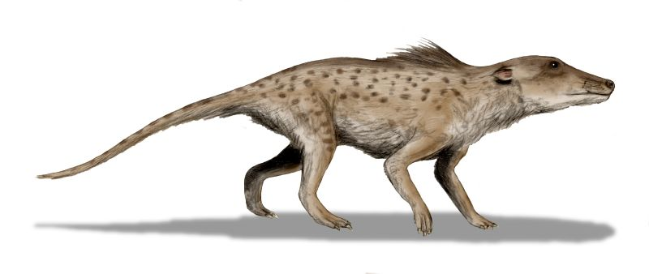
2nd Gen
"Pakicetus BW" by Nobu Tamura
Constraints
  Signal Width, Spacing, Shielding
Implementation
  Automated full-custom placement, routing
Verification
  Pre-layout SPICE timing simulation on all signals
  Post-layout SPICE timing simulation on all signals
Effort
  Effort = 0.25*(1st gen effort)
Size
  Baseline size = 0.8* (1st gen size)

Slide 7
2nd Gen pros/cons, drivers for migration
"Pakicetus BW" by Nobu Tamura
Timing verification was verification time consuming (post-layout
timing simulation for every path)
Crosstalk avoidance was done by coaxial shielding -> overkill?
Wanted to move to
Timing constraints
Static timing analysis of cosntraints, pre- and post- layout.
Quicker turnaround time
Smaller area

Slide 8

3rd Gen
Source
Constraints
  Max_delay, cycle time constraints (SDC)
Implementation
  P&R
Verification
  STA for low-frequency signals
  Post-layout SPICE for a few high-frequency signals
Effort
  Baseline effort = 0.1*(1st gen effort)
Size
  Baseline size = 0.25*(1st gen size)

Slide 9
Discussion
Main drivers to move from full-custom implementation to P&R are
  Ease of verification (STA vs. timing simulation vs. physical constraints verification)
  Area reduction (Crosstalk avoidance through PnR instead of shielding)
  Execution speed (PnR tools vs. manual effort) provides more opportunities for optimization.
Moving from physical constraints to timing constraints
  Use closed-form formulas to go from width/spacing/shielding to delay/crosstalk
  Enables leveraging timing simulations and eventually STA

Slide 10
Thank you
Follow us on:
  For more information on Qualcomm, visit us at:
  www.qualcomm.com & www.qualcomm.com/blog

