Slide 1
A Timing Graph Based Approach to Mode Merging
Subramanyam Sripada
Murthy Palla
Synopsys Inc.
March 12, 2013

Slide 2
Agenda
Motivation
Background
Approach
Illustration of Approach
Results

Slide 3
Design/Complexity Projections
An idea of what you can expect
3X Growth
2015-2020
Source: ITRS 2013
Source: Synopsys Customer & Partner Data

Slide 4

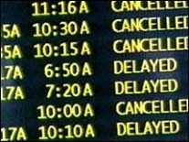
Dealing With Scenario Growth
Option #1: Select the ‘worst case’ mode(s)
Time-consuming
Risky
Option #2: Manual mode merging
Option #3: Increase hardware budget
Less risky
Costly
Option #4: Accept more project delays

Slide 5
Mode Merging
It is increasingly common to have large numbers of scenarios for implementation and signoff
Mode merging helps by collapsing modes where possible
Analysis with merged modes requires fewer resources
mode2
mode1
mode n
merged mode 3
merged mode 2
merged mode 1
"The Automatic Generation of Merged-Mode Design Constraints", DAC, 2009 User Track describes limited approach

Slide 6
Our Approach
Use timing graph “behavior” to merge modes
  If a path is timed in an individual mode, the path is timed in the merged mode
  if a path is timed in the merged mode, the path is timed in at least one individual mode
Merge modes into multiple mode groups automatically
  User need not specify which modes to merge

Slide 7
Automatic Mode Merging
Given N modes, merge them into M modes automatically
  Determine pair-wise compatibility among modes
    Can mode A be merged with mode B?
      If not, can A’ be merged with B? (A’ exists in theory only – details later)
  Identify “cliques” in mode compatibility graph
  Merge all modes in each clique by using an algorithm based on timing graph

Slide 8
Mode Compatibility Graph
M2
m8
m1
m3
m2
M3
m4
m6
m5
m7
m9
M1
Identify sub-graphs where every node in sub-graph is
connected to every other node in sub-graph

Slide 9
Exception Transformation
FF1
FF2
CLKA
0
CLKB
1
mux1
Mode 1:
create_clock –name CLKA …
set_case_analysis 0 [mux1/S]
set_multicycle_path 2 –from [FF1/CP]
Mode 2:
create_clock –name CLKB …
set_case_analysis 1 [mux1/S]
Mode 1+2:
create_clock –name CLKA …
create_clock –name CLKB …
set_multicycle_path 2 –from [FF1/CP]
Mode 1’:
create_clock –name CLKA …
set_case_analysis 0 [mux1/S]
set_multicycle_path 2 -from [get_clocks CLKA] –through [FF1/CP]
Mode 2:
create_clock –name CLKB …
set_case_analysis 1 [mux1/S]
Mode 1’+2:
create_clock –name CLKA …
create_clock –name CLKB …
set_multicycle_path 2 –from [get_clocks CLKA] –through [FF1/CP]

Slide 10
Generation of one merged mode
Merged mode generation:
  Initial Merged Mode: Generating a super set of timing relationships
  Refinement: Eliminating the extraneous timing relationships based on merged mode verification
    Clock Refinement
    Data Refinement

Slide 11
Timing Relationship Definition
Mode 1:
set_case_analysis 0[get_port SE]
FF1
FF2
Mode 2:
set_case_analysis 1[get_port SE]
clka
clkb
0
sel
1
Merged Mode:
set_false_path –from [get_clocks clkb] –to [get_clocks clka]
Timing SP | Timing EP | Launch clock | Capture clock | Min/ Max | SDC1 State | SDC2 State | Merged SDC | Result
FF1/CP | FF2/D | clka (r) | clka(r) | both | TRUE | Not present | TRUE | Match
FF1/CP | FF2/D | clka (r) | clkb(r) | both | Not present | Not present | TRUE | Mismatch
FF1/CP | FF2/D | clkb (r) | clkb(r) | both | Not present | TRUE | TRUE | Match

Slide 12
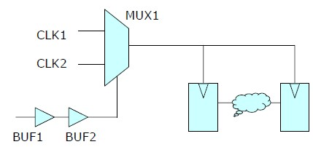
Merged Mode Constraint Example
Mode1:
create_clock –p 1 CLK1
create_clock –p 2 CLK2
set_case_analysis 1 BUF1/Z
Mode2:
create_clock –p 1 CLK1
create_clock –p 3 CLK2
set_case_analysis 0 BUF2/Z
0
1
ff1
ff2
# Merged from modes: mode1, mode2
# Run merged mode with corners: slow
# /test/mode_merging/mode1.sdc, line 1;
# /test/mode_merging/mode2.sdc, line 1
create_clock -name CLK1 -period 1 -waveform { 0 0.5 } -add [get_ports {clk1}]
# /test/mode_merging/mode1.sdc, line 2;
create_clock -name CLK2 -period 2 -waveform { 0 1 } -add [get_ports {clk2}]
# /test/mode_merging/mode2.sdc, line 2
create_clock -name CLK2_1 -period 3 -waveform { 0 1.5 } -add [get_ports {clk2}]
set_clock_groups -logically_exclusive -name CLK1_1 -group [get_clocks {CLK1}] \
-group [get_clocks {CLK2 CLK2_1}]
set_clock_groups –physically_exclusive –name CLK2_1 –group [get_clocks {CLK2}] –group [get_clocks {CLK2_1}]
Step 1 Constraints
Step 2 Constraints

Slide 13

Why Can’t Some Modes be Merged?
# mode1
create_clock –name clk_mode1 [get_ports C1] …
create_generated_clock –name gclk_mode1 \
[get_pins buf1/Z] …
# mode2
create_clock –name clk_mode2 [get_ports C1] …
If mode1 and mode2 were merged, gclk_mode1 would block clk_mode2
If a similar generated clock is added to mode2, mode1 and mode2 can be merged
A –test_only option to resolve constraint issues before mode merging for best results

Slide 14
Slew Pessimism
FF
Mode 1:
set_case_analysis 0[get_port sel]
(Slew at MUX/Z comes from MUX/A)
A
B
0
1
sel
Mode 2:
set_case_analysis 1[get_port sel]
(Slew at MUX/Z comes from MUX/B)
Merged Mode:
Slew at MUX/Z comes from the worst of the two arcs

Slide 15
Delta Delay Pessimism
Mode 1:
create_clock –p 10 CLK –name clk1
set_case_analysis 0 U2/A
(Aggressor is quiet)
U2
FF
U1
CLK
Mode 2:
create_clock –p 20 CLK –name clk2
(Aggressor is active)
Merged mode:
create_clock –p 10 CLK –name clk1
create_clock –p 20 CLK –name clk2 -add
Aggressor is active => Path captured at FF by clock clk1 will see delta delay

Slide 16
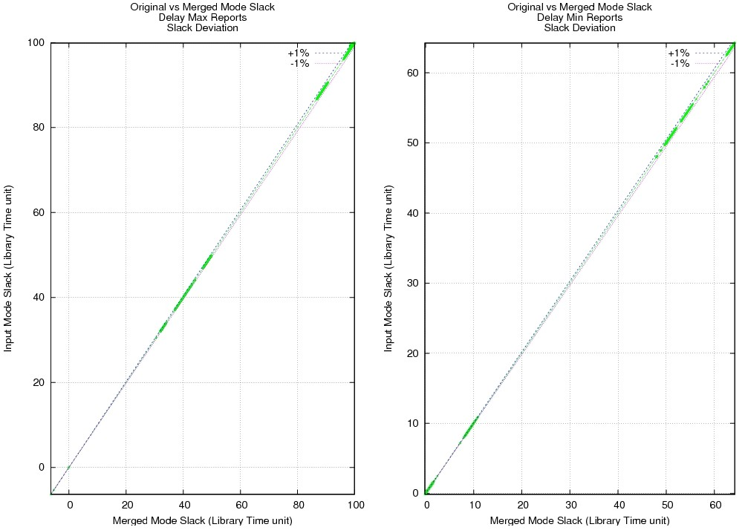
Mode Merging Quality
Industry design with >400K endpoints
Comparing Max and Min Slack Delays for a customer design using merged constraints (x axis) with original constraints (y axis).
  All slacks deviate by less than 1% (w.r.t. clock period) demonstrating minimal change introduced by PrimeTime SDC constraint mode merging

Slide 17
Mode Merging Runtime Benefits
Merged mode constraints have low overhead on STA runs compared with a single scenario pre-merge STA run

Slide 18
Summary
Mode merging is a key technology to delivering on STA initiatives to meet the needs of GigaScale, GigaHertz and Giga-Complex designs
A complete automatic solution of merging N modes to M modes is presented
Accuracy, performance and capacity improvements are presented

Slide 19
Appendix

