Slide 1
Solving the Scalability Challenges for Timing Constraints
Qiuyang Wu
2015.3.13

Slide 2
Outline
This talk answers the following questions regarding timing constraints:
  What are the key scalability challenges?
  What are the available solutions?

Slide 3
Design Complexity Trends
An idea of what you can expect
3X Growth
2015-2020
Source: ITRS 2013
Source: Synopsys Customer & Partner Data

Slide 4
The Key Scalability Challenges
Increasing Design Reuse ➔ Direct integration with legacy constraints
  Challenge#1: Constraint self-consistency
    How to check whether the mix/match constraints make sense?
Increasing Design Size ➔ Hierarchical flow throughout is a must-have
  Challenge#2: Hierarchical constraints management
    How to create block constraints from chip specification?
    How to check consistency between top and block?
    How to ensure consistency of evolving constraints?
Increasing Design Complexity ➔ More corners/modes to signoff
  Challenge#3: Scenario reduction through mode management
    How to merge the modes to reduce STA runs?
    How to ensure coverage of merged constraints?

Slide 5

Consequences are expensive
Space shuttles blow-up
  Millions of parts
  Fail could be caused by
    1 O-ring
    1 line of code
IC Chips fail
  100’s Million cells
  100k-1M lines of constraints
  Fail could be caused by
    1 line of SDC : incorrect false path, extra case, blocked clocks, etc.
Notes:
License change made in Sept 2014
2014.12 first release where GCA was not shipped as a separate add-on material

Slide 6
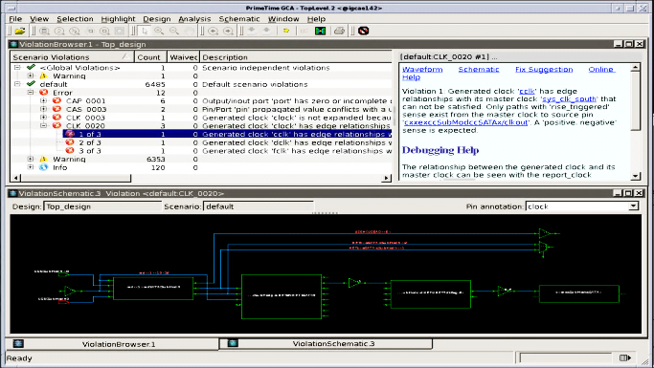
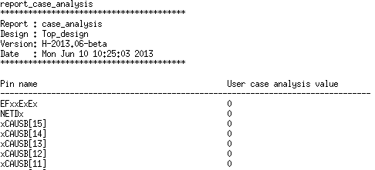
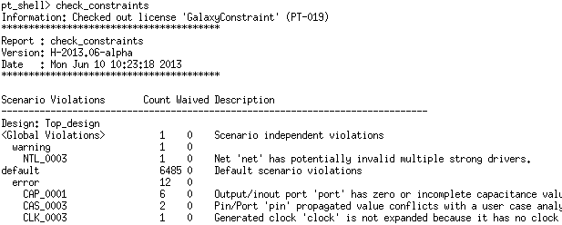
Dealing with Complexity
An integrated easy-to-use IDE for constraints
  Well established best-practice
    100+ pre-defined common rules
    clocks, gen-clocks, senses, case analysis, exceptions, IO, etc.
    Back trace issues to original user inputs : file, line number, etc.
  Make your own rules
    Decide and define your care-abouts (DOs/DONTs) using familiar Tcl interface
Notes:
License change made in Sept 2014
2014.12 first release where GCA was not shipped as a separate add-on material

Slide 7
Dealing with Changes
In real life: constraints change!
Equivalence must be checked and managed
  Catch violations when timing effects differ from intention
  Difficulty: equivalence is contextual, or semantics, not syntax!
R1
inv
R3
R2
and
R4
set_multicyle_path 3 –thr inv/Z
set_multicycle_path 2 -thr and/Z
=?=
set_multicycle_path 3 -from R1/CP
set_multicycle_path 2 –thr and/Z
Notes:
For this example:
The mcp 3 exceptions look equivalent
The mcp 2 exceptions look equivalent
But the precedence changes when the mcp 3 is changed to a ff.

Slide 8
Hierarchy: Constraint Extraction
Targeted for a top down flow with golden flat constraints
Full Chip
Golden Signoff Constraints
Constraint
Extraction
Chip
Timing
Analysis
Block
Constraints
(Signoff)
Block
Timing
Analysis
Fully-automated & close-form hierarchical timing
Can produce accurate IO context for block closure

Slide 9
Hierarchy: Consistency Checking
Analyze and check Block-to-Top constraint consistency
Most valuable for bottom-up constraint integration (IP, etc.)
SOC
Input Delay
CORE
Output Delay
exception
Clock
Signals
Clock specification | Case analysis
Exceptions | Disable timing
Clock groups | IO delays
…

Slide 10
Dealing with Scenarios: Merge Modes
Automatically merge N modes to M, M<N, ideally M=1
m1.sdc
merged.sdc
PrimeTime
Example:
FF1
FF2
set_case_analysis 0[get_port SE]
+
clka
set_case_analysis 1[get_port SE]
clkb
0
1
=
sel
set_disable_timing SE
set_clock_group –logically_exclusive -group {clka} –group {clkb}

Slide 11
Conclusions
Scalability challenges of constraint management
  Complexity
  Hierarchy
  Scenarios
Complete suite of constraint solutions, natively available within the golden STA solution
  Self-consistency of large volume of complex constraints
  Hierarchical constraint creation and consistency check
  Mode merging to reduce timing scenarios

