Slide 1


Efficient IC Statistical Modeling and Extraction Using a Bayesian Inference Framework
Li Yu, Ibrahim (Abe) Elfadel¹, and Duane Boning
Electrical Engineering and Computer Science
Microsystems Technology Laboratories, MIT
¹Masdar Institute of Science and Technology

Slide 2
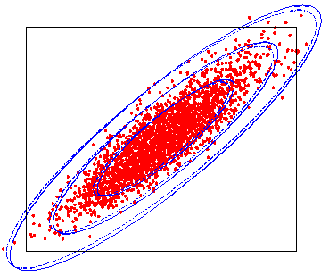
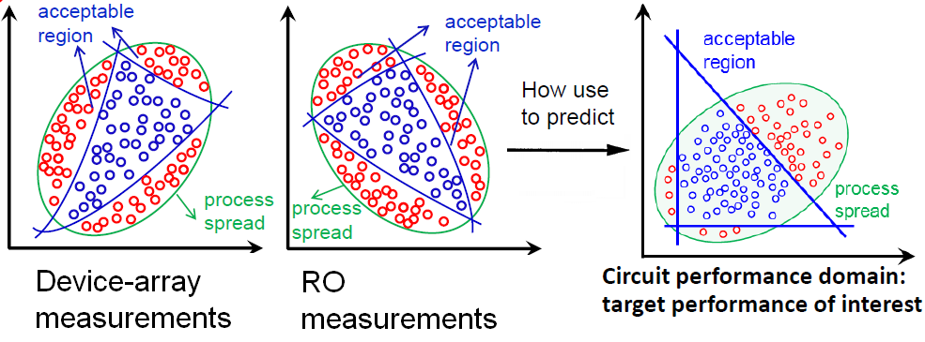
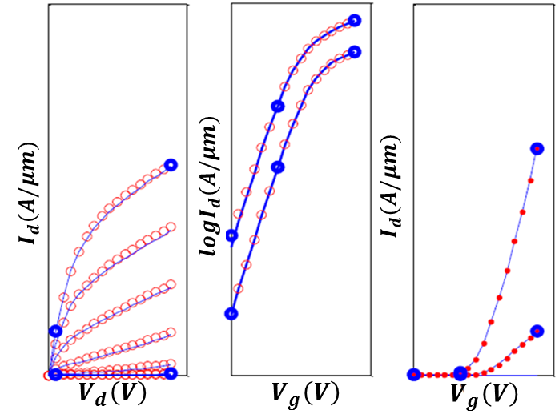
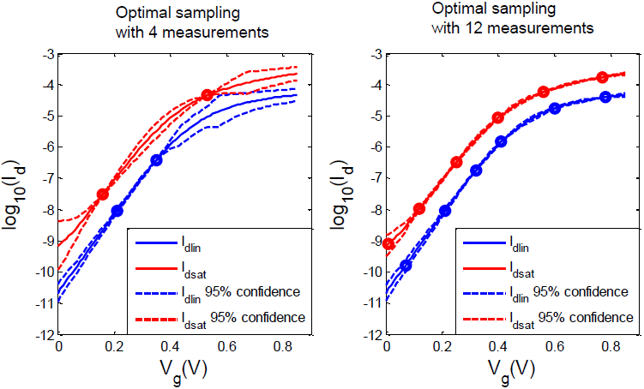
Device Variation & Statistical Compact Modeling Issues
How to predict circuit performance using mixtures of on-chip test measurements?
How to build valid statistical models enabling robust circuit design?
What is the lower bound for the number of IV measurements to fit a model
and how select those measurements?
How to efficiently extract transistor parameters ?
Notes:
In this thesis, we are try to solve the following key problems in device variation & statistical modeling area. …

Slide 3
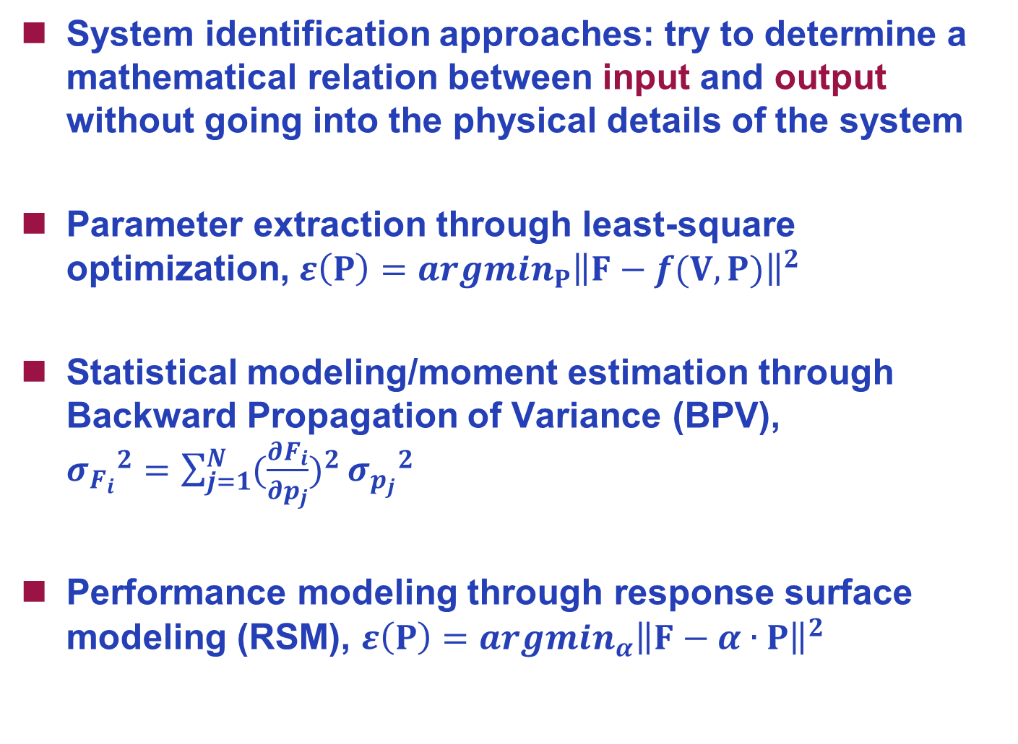
Traditional Methods: System Identification Approaches
System identification approaches: try to determine a mathematical relation between input and output without going into the physical details of the system
Parameter extraction through least-square optimization, $ε\left(P\right)={argmin}_{P}{\left\|F−f(V,P)\right\|}^{2}$
Statistical modeling/moment estimation through Backward Propagation of Variance (BPV), ${σ_{F_{i}}}^{2}=\sum_{j=1}^{N}{{(\frac{∂F_{i}}{∂p_{j}})}^{2}}{σ_{p_{j}}}^{2}$
Performance modeling through response surface modeling (RSM), $ε\left(P\right)={argmin}_{α}{\left\|F−α∙P\right\|}^{2}$
Notes:
Traditionally, these problems are attacked by system identification approaches, which try to determine a mathematical relationship between input and output without going into the detail of the system. …

Slide 4
Limitations in System Identification Approaches
Challenges with solution uniqueness/expressiveness
  We wish to extract parameters with physical meaning
  We need to preserve physical correlation among parameters
  We need to limit the parameter values to a specific domain
Challenges from over-fitting
  We wish to model the system with limited measurements/samples
  Some methods require uncorrelated measurements/variables
  Need to perform feature selection
Challenges with noisy data
  Equal weight is assigned to different measurements
  We wish to identify data with systematic offset or measurement noise
Notes:
However, there are several problem associated with the system id approaches. …

Slide 5
Our Approach to IC Statistical Modeling and Extraction
MIT Virtual Source (MVS) Compact MOSFET Model (Antoniadis et al.)
  Ultra-compact model: small number of physically based parameters
  Applicable to nano-scale MOS devices
Bayesian Extraction Method with Very Limited Data
  Fit model from small number of early device and monitor measurements
Statistical IC Modeling and Extraction Methods
Statistical Formulations
  Variation model and extraction using Back-Propagation of Variance (BPV)
  Projection onto physical subspace spanned by MVS model (in contrast to PCA projections)
Applications
  Early technology evaluation and trends
  Efficient circuit performance evaluation
  Efficient statistical library cell timing characterization
Shaloo Rakheja; Dimitri Antoniadis (2013), "MVS 1.0.1 Nanotransistor Model (Silicon),“ http://nanohub.org/resources/19684.
Notes:
In my thesis, we leverage the MIT virtual source model, proposed by prof. Dimitri Antoniadis. We introduce efficient statistical IC modeling and extraction methods. We further propose statistical formulations such as physical subspace projection to project measurements onto a MVS model subspace. We also introduce a Bayesian extraction method to fit from limited number of measurements, and propose optimal sampling method for IV measurements. This allows us to solve the following problems.

Slide 6
Outline
Introduction
Foundation
  MIT Virtual Source (MVS) Transistor Model: A Physical Solution
Performance Estimation with Mixed & Small Size Samples
  Physical Subspace Projection
  Maximum a Posteriori (MAP) Estimation
Compact Model Parameter Extraction
  Bayesian Inference: Learning Precision and Prior at Different Biases
  Optimal Sampling of Transistor Measurements
Statistical Library Characterization
  Novel Delay/Slew Model
  Exploring Sparsity in Library Input Space
Summary/Acknowledgement
Notes:
Let’s first introduce the foundation of the work, MIT virtual source transistor model.

Slide 7
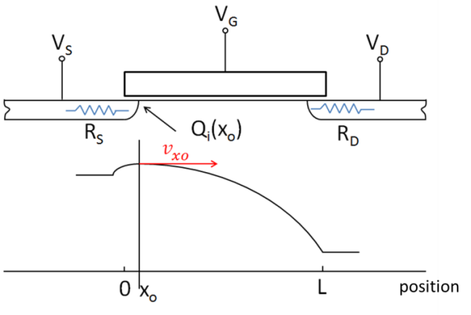
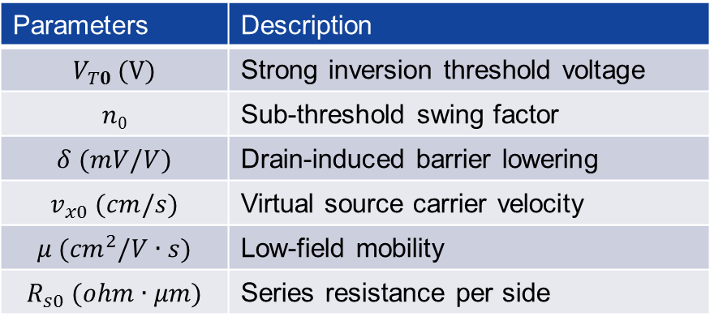
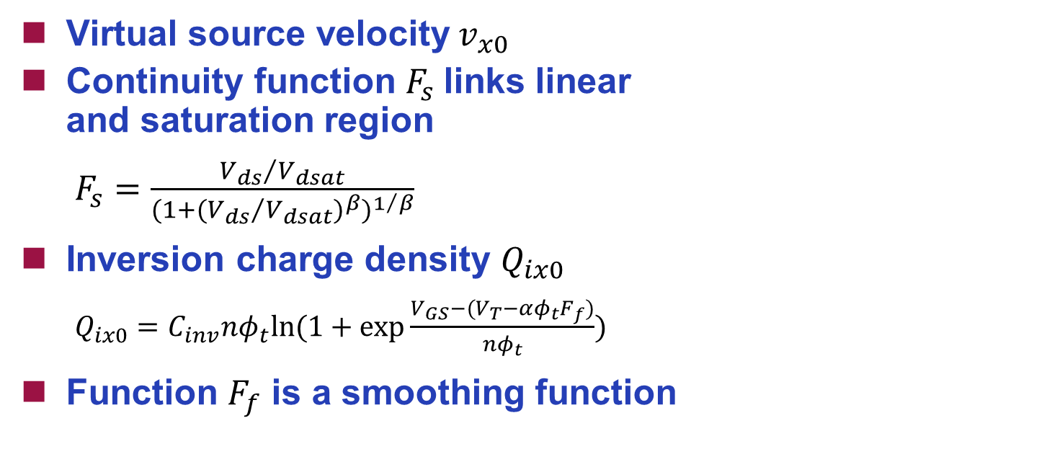
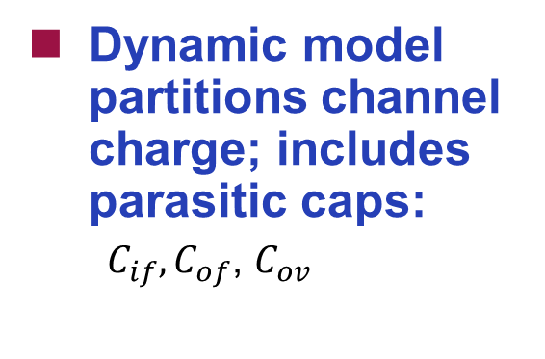
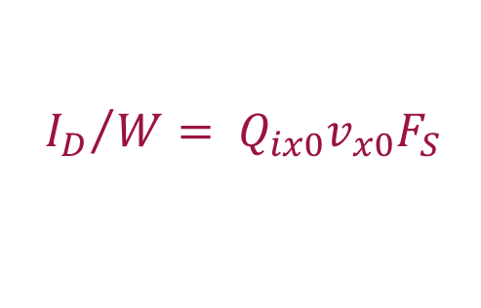
MIT Virtual Source (MVS) Model
Virtual source velocity${ v}_{x0}$
Continuity function $F_{s}$ links linear
and saturation region
  $F_{s}=\frac{{V_{ds}}/{V_{dsat}}}{{(1+{({V_{ds}}/{V_{dsat}})}^{β})}^{1/β}}$
Inversion charge density $Q_{ix0}$
  $Q_{ix0}=C_{inv}nφ_{t}ln⁡(1+exp\frac{V_{GS}−(V_{T}−αφ_{t}F_{f})}{nφ_{t}})$
Function $F_{f}$ is a smoothing function
${I_{D}}/W= Q_{ix0}v_{x0}F_{S}$
Parameters | Description
$$V_{T0} (V)$$ | Strong inversion threshold voltage
$$n0$$ | Sub-threshold swing factor
$$δ (mV/V)$$ | Drain-induced barrier lowering
$$v_{x0} (cm/s)$$ | Virtual source carrier velocity
$$μ ({cm}^{2}/V∙s)$$ | Low-field mobility
$$R_{s0} (ohm∙μm)$$ | Series resistance per side
Dynamic model partitions channel charge; includes parasitic caps:
  $C_{if}, C_{of}$, $C_{ov}$
Shaloo Rakheja; Dimitri Antoniadis (2013), "MVS 1.0.1 Nanotransistor Model (Silicon),“ http://nanohub.org/resources/19684.
Notes:
The MIT virtual source model is a physical based ultra-compact model including only 23 parameter. The core concept in the MVS model is that in short-channel devices, vxo does not depend on Vds except for DIBL effects. In the MVS model, the drain current of a MOSFET normalized by width can be described using this equation. … The key I-V parameters for the MVS model includes …

Slide 8
Outline
Introduction
Foundation
  MIT Virtual Source (MVS) Transistor Model: A Physical Solution
Performance Estimation with Mixed & Small Size Samples
  Physical Subspace Projection
  Maximum a Posteriori (MAP) Estimation
Compact Model Parameter Extraction
  Bayesian Inference: Learning Precision and Prior at Different Biases
  Optimal Sampling of Transistor Measurements
Statistical Library Characterization
  Novel Delay/Slew Model
  Exploring Sparsity in Library Input Space
Summary/Acknowledgement
Notes:
In next Section, we will introduce a performance estimation algorithm which could be applied to mixed and small size measurements. In product, we place on-chip monitor circuits around the die. Those circuit include both device arrays and simple ring oscillator arrays. We wish to predict the system performance using simple measurements result from those on-chip measurements.

Slide 9
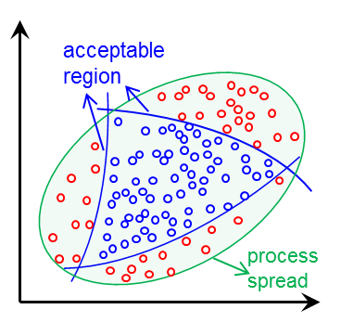
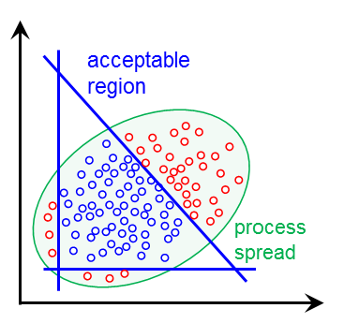

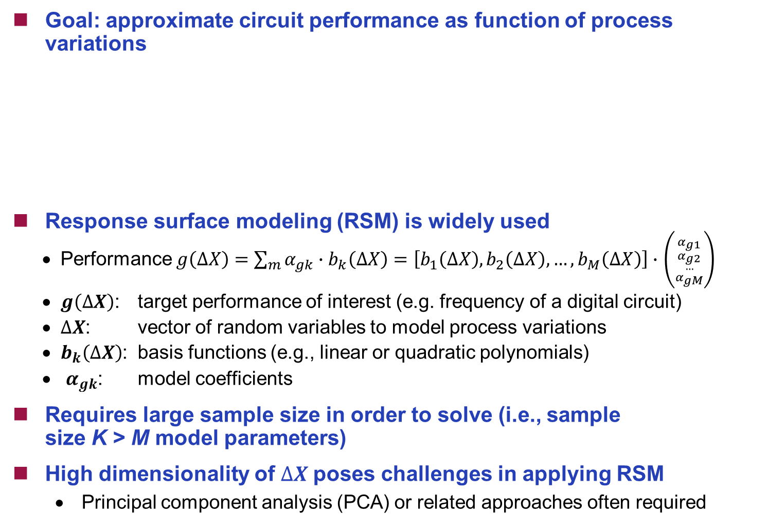
Challenge: Statistical Performance Modeling with Mixed and Limited Data
Goal: approximate circuit performance as function of process variations
Response surface modeling (RSM) is widely used
  Performance $g\left(∆X\right)=\sum_{m}{α_{gk}}∙b_{k}\left(∆X\right)=\left[b_{1}\left(∆X\right),b_{2}\left(∆X\right),…,b_{M}\left(∆X\right)\right]∙$ $\left({{α_{g1} \atop α_{g2}} \atop {… \atop α_{gM}}}\right)$
  $g\left(∆X\right)$: target performance of interest (e.g. frequency of a digital circuit)
  $∆X$: vector of random variables to model process variations
  $b_{k}\left(∆X\right)$: basis functions (e.g., linear or quadratic polynomials)
  $α_{gk}$: model coefficients
Requires large sample size in order to solve (i.e., sample
size K > M model parameters)
High dimensionality of $∆X$poses challenges in applying RSM
  Principal component analysis (PCA) or related approaches often required
Performance modeling
Process domain
Performance domain
X. Li et al., “Projection-based performance modeling for inter/intra-die variations,” ICCAD, 2005.
Notes:
The challenge here is how to approximate circuit performance using limited and mixed measurements. Response surface modeling (RSM) is widely used
method that model the system with a vector of basis function times a vector of coefficients alpha. However, it requires large sample size in order to solve alpha and we usually need to reduce the dimension of the measurements through a Principal component analysis (PCA) method.

Slide 10
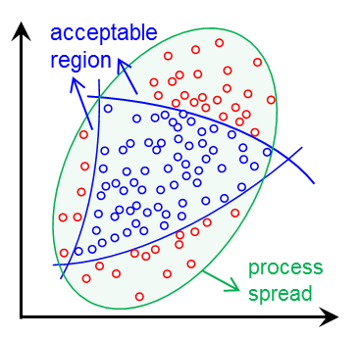

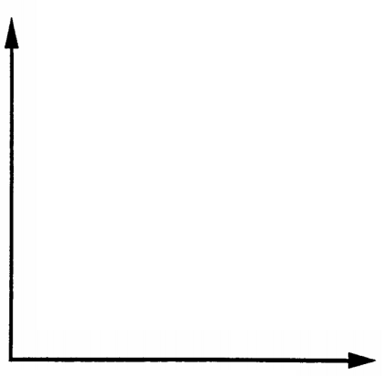
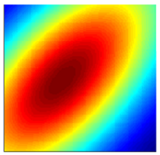


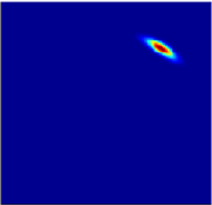
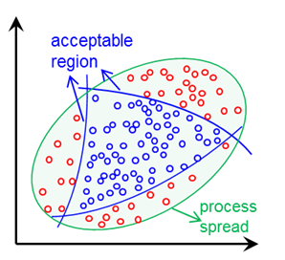


Proposed Method – Physical Subspace Projection and Maximum a Posteriori Estimation
Traditional Method
PCA
RSM
Performance measurements
Principal components
Target performance
Proposed Method
Physical subspace projection
MAP
Process
Shift
calibration
Device-array measurements
Physical subspace projection
Performance domain:
target performance of
interest
RO measurements
Performance domain:
measurements from test structures
Probability map of physical subspace: {$V_{tn},$ $V_{tp}, v_{xn},$ $v_{xp}$}
Notes:
Here we proposed a new framework by propose a technique call physical subspace project and Maximum a Posteriori Estimation (MAP). Compared with the traditional method that utilize PCA and RSM that requires a large number of training measurements, our method preserve the physical link between the measurements and MVS subspace, therefore we could use circuit simulation result to approximate system performance. We only need to calibrate the process shift using a few training data.

Slide 11
    Physical Subspace Projection: Intuition
MVS model simplifies the complex process to capture a target transistor model from measurement by
  Limited number of parameters
  Most parameters are directly inferable from IV curve
A gap still exists with traditional RSM approaches
  How to translate backwards from measurements in the performance domain (e.g., RO frequency) to MVS domain?
  Typically very small number of measurements are monitored for post-silicon validation purposes and therefore a low dimensional subspace is preferable
  Hard to weight mixed measurements from different types of measurement structures, i.e., device & circuit structures (RO’s)
Idea: find the best (most likely) physical MVS model parameters that explain past and new measurement data
Notes:
The intuition of the physical subspace project is that the MVS model only has limited number of parameters and most of them are directly inferable from IV curve. However, a gap still exists on how to translate backwards from measurements in the performance domain to the MVS subspace. It motivate us to use the MVS model as a basis for physical subspace projection

Slide 12
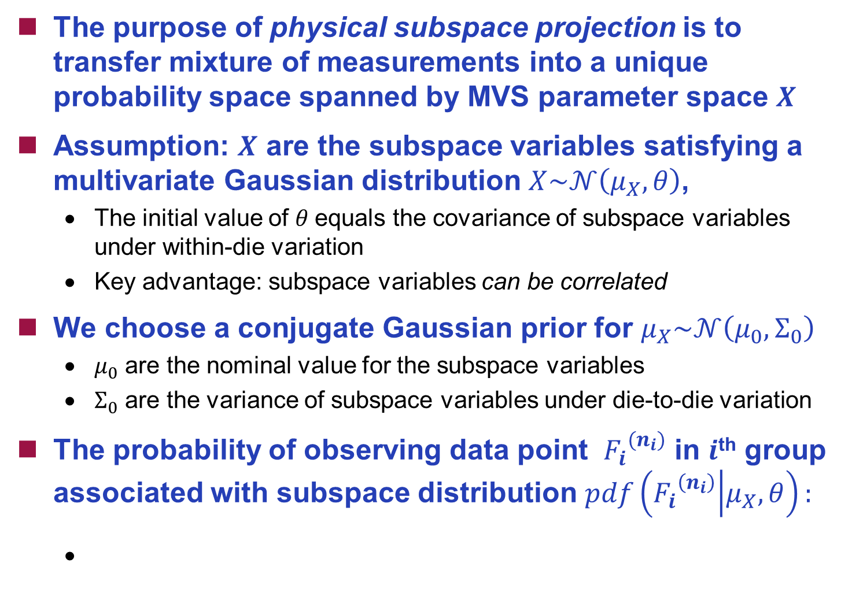
(1) Physical Subspace Projection
The purpose of physical subspace projection is to transfer mixture of measurements into a unique probability space spanned by MVS parameter space $X$
Assumption: $X$ are the subspace variables satisfying a multivariate Gaussian distribution $X\sim 𝒩\left(μ_{X},θ\right)$,
  The initial value of $θ$equals the covariance of subspace variables under within-die variation
  Key advantage: subspace variables can be correlated
We choose a conjugate Gaussian prior for $μ_{X}\sim 𝒩\left(μ_{0},Σ_{0}\right)$
  $μ_{0}$ are the nominal value for the subspace variables
  $Σ_{0}$ are the variance of subspace variables under die-to-die variation
The probability of observing data point ${F_{i}}^{(n_{i})}$ in $i$^{th} group associated with subspace distribution $pdf\left({F_{i}}^{\left(n_{i}\right)} | μ_{X},θ\right):$
Notes:
The purpose of physical subspace projection is to transfer mixture of measurements into a unique probability space spanned by MVS parameter space $X.$
Our assumption here is that $X$ satisfying a multivariate Gaussian distribution mux and theta. Notice that we both values are unknown and we only know their prior value. The probability of observing each data point is shown in this equation.

Slide 13
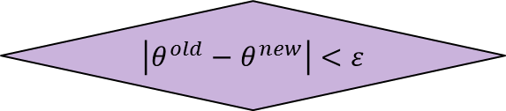
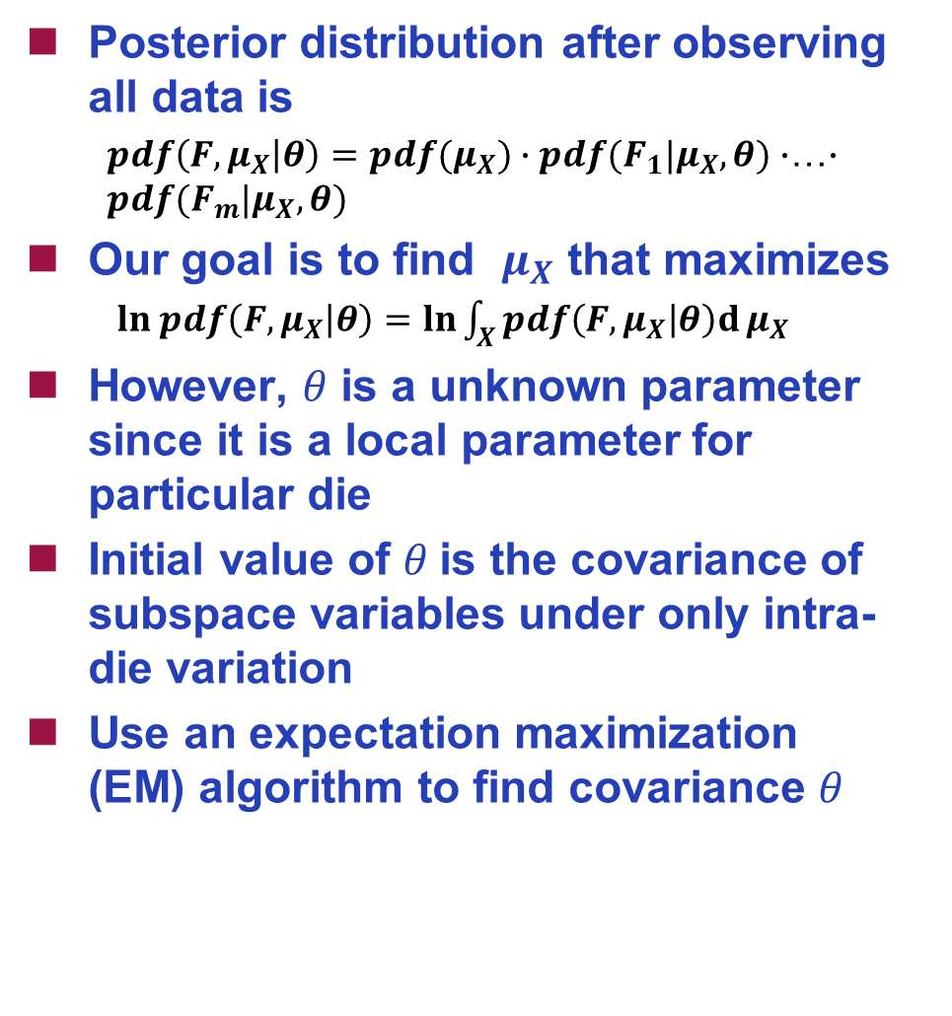
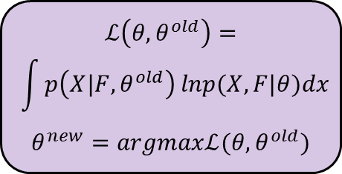
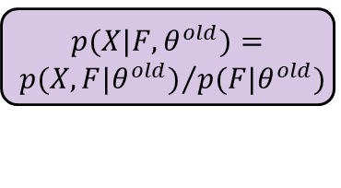


(2) Maximum a Posteriori Estimation
Posterior distribution after observing all data is
  $pdf\left(F,μ_{X} | θ\right)=pdf(μ_{X})∙pdf(F_{1}|μ_{X},θ)∙$…$∙$ $pdf(F_{m}|μ_{X},θ)$
Our goal is to find $μ_{X}$ that maximizes
  $ln pdf\left(F,μ_{X} | θ\right)=ln\int_{X}^{ }{pdf\left(F,μ_{X} | θ\right)d}μ_{X}$
However, $θ$ is a unknown parameter since it is a local parameter for particular die
    Initial value of $θ$is the covariance of subspace variables under only intra-die variation
Use an expectation maximization
(EM) algorithm to find covariance $θ$
Initiate $θ$
No
$$θ^{old}=θ^{new}$$
$$p({X|F,θ}^{old})=$$
$${p({X,F|θ}^{old})}/{p({F|θ}^{old})}$$
$$ℒ\left(θ,θ^{old}\right)=$$
$$\int{p\left({X|F,θ}^{old}\right)}lnp(X,F|θ)dx$$
$$θ^{new}=argmaxℒ(θ,θ^{old})$$
$$\left|θ^{old}−θ^{new}\right|<ε$$
Yes
stop
Notes:
After physical subspace projection, we try to find $μ_{X}$ that maximizes posteriori probability. Since both $μ_{X}$ and $θ$ are unknown, we solve it using a EM algorithm in an iterative way.

Slide 14
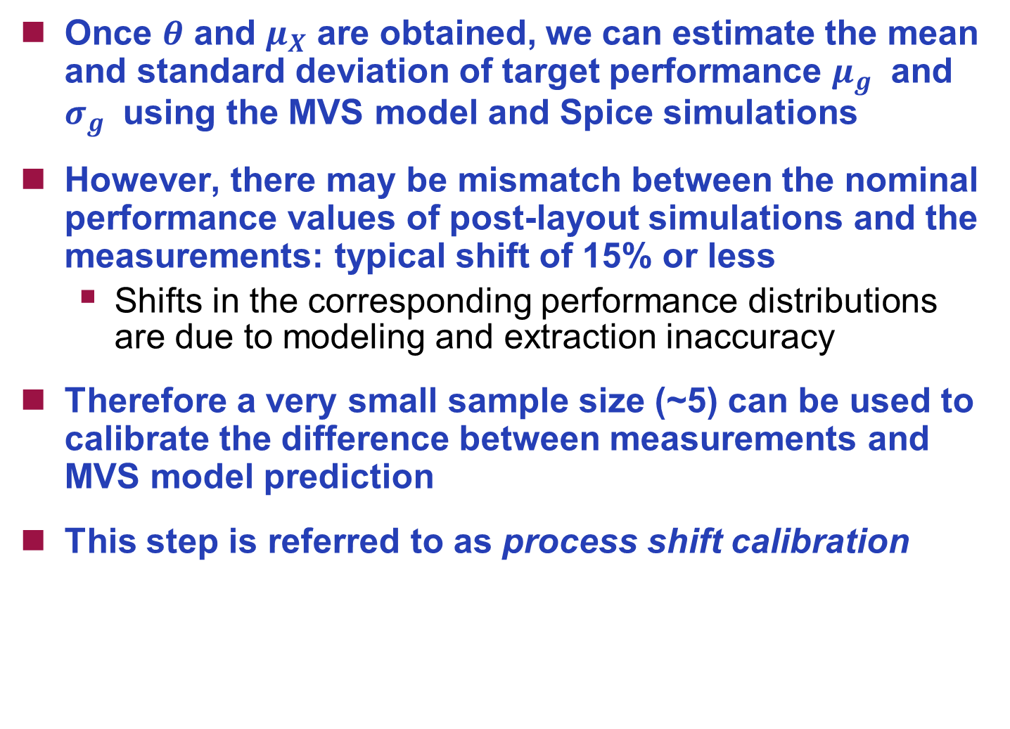
(3) Prediction of Performance using MVS Model
Once $θ$ and $μ_{X}$ are obtained, we can estimate the mean and standard deviation of target performance $μ_{g}$ and $σ_{g}$ using the MVS model and Spice simulations
However, there may be mismatch between the nominal performance values of post-layout simulations and the measurements: typical shift of 15% or less
  Shifts in the corresponding performance distributions are due to modeling and extraction inaccuracy
Therefore a very small sample size (~5) can be used to calibrate the difference between measurements and MVS model prediction
This step is referred to as process shift calibration
Notes:
The last step is to calibrate the process shift before the simulation result and measurements. A very small sample size (~5) can be used to calibrate the difference between measurements and MVS model prediction.

Slide 15
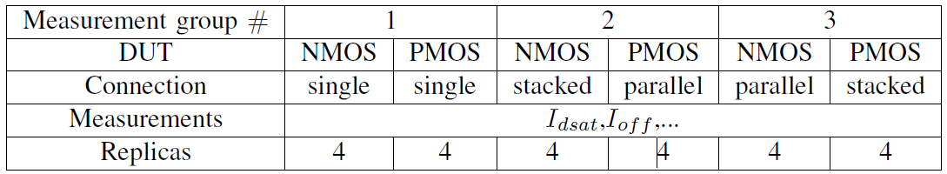
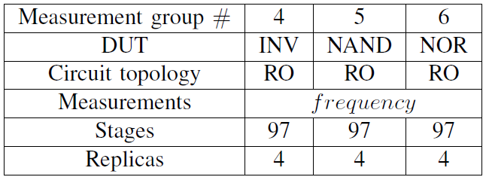
Experimental Results
Measurements from on-chip test structures
Designed in 28-nm bulk CMOS process
Measured from 3186 dies in 27 wafers
Test sites and structures:
  Device-array
  RO-array
Notes:
Now let’s show some experiment result.

Slide 16
Validation (I): Compared with Naïve Approach
Naïve approach: Model the output (RO frequency) as function of mean values from measurement of a single type of device DUT (e.g., individual NMOS, PMOS devices)
Our approach: Capture correlations across multiple DUT types (use a mixture group of measurements)
Performance modeling
Process domain
Performance domain
Prediction of NOR RO frequency using mean of single group of transistor DUT measurements
3.25x samples reduction
Prediction of NOR RO frequency using mean of mixture group of transistor DUT measurements
~10x samples reduction
Prediction of NOR RO frequency using mean of mixture group of both transistor and RO DUT measurements (proposed method)
Relative prediction error for DUT 6 (NOR RO) versus replicate samples per die (sample size) using different DUT group means to fit models.

Slide 17
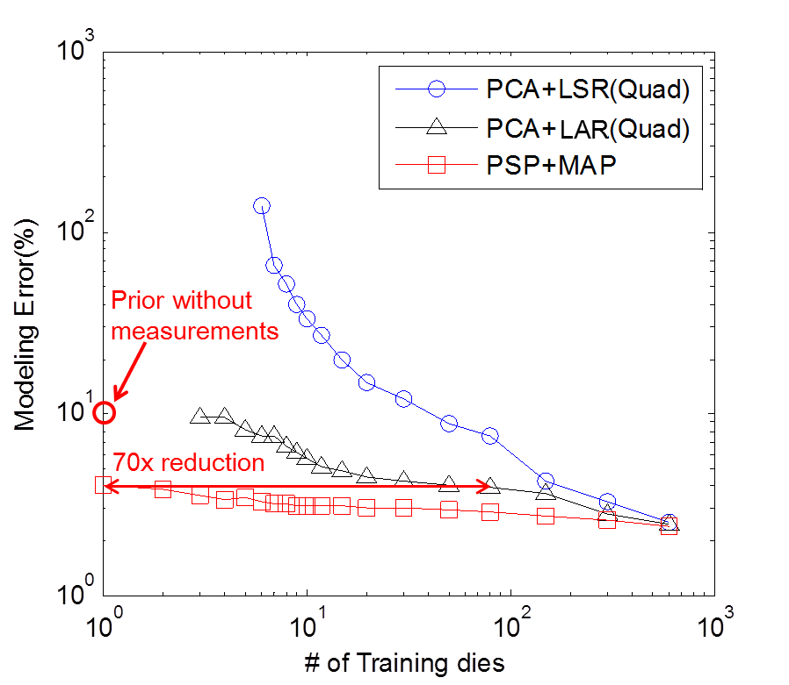
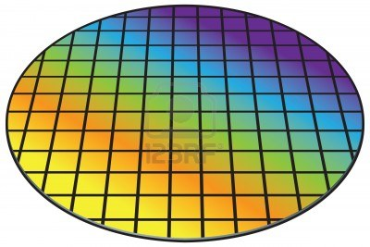
Validation (II): Compared with PCA+RSM Method
Two methods are compared with our proposed method
  Standard least square regression (LSR) after PCA (blue circles)
  Advanced least angle regression (LAR) utilizing sparsity after PCA (black triangles)
  Proposed method: physical subspace projection with MAP (red squares)
27 folds
……
Cross validation on 27 wafers (3186 die)
Relative prediction error for DUT 6 group (NOR RO) versus number of training dies

Slide 18
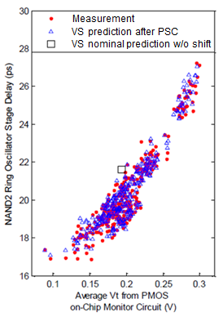
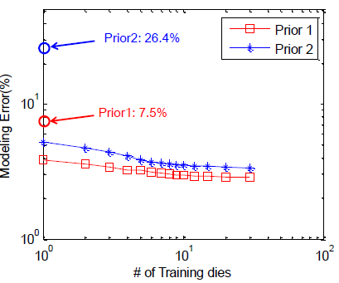
Comparison for Priors with Different Prediction Error

Slide 19
Outline
Introduction
Foundation
  MIT Virtual Source (MVS) Transistor Model: A Physical Solution
Performance Estimation with Mixed & Small Size Samples
  Physical Subspace Projection
  Maximum a Posteriori (MAP) Estimation
Compact Model Parameter Extraction
  Bayesian Inference: Learning Precision and Prior at Different Biases
  Optimal Sampling of Transistor Measurements
Statistical Library Characterization
  Novel Delay/Slew Model
  Exploring Sparsity in Library Input Space
Summary/Acknowledgement
Notes:
In the next section, we will introduce a novel compact model parameter extraction algorithm using Bayesian inference.

Slide 20
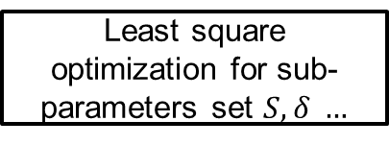
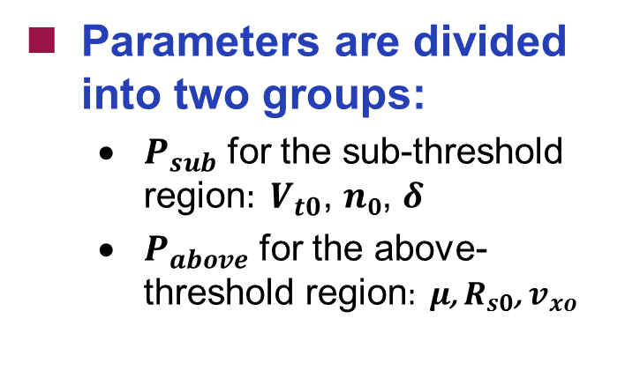
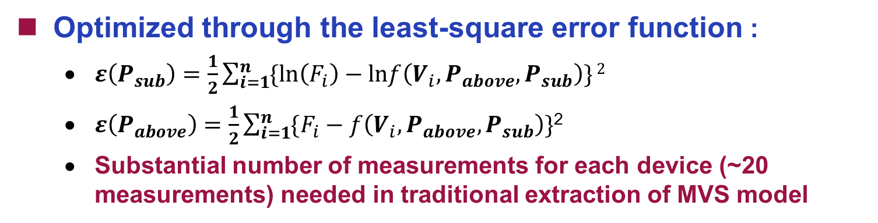
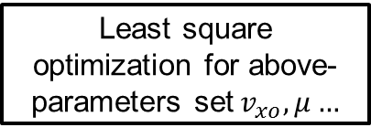
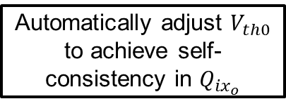
Previous Optimization Flow for
I-V Parameter Extraction in the MVS Model
Automatically adjust $V_{th0}$ to achieve self-consistency in $Q_{{ix}_{o}}$
Parameters are divided into two groups:
  $P_{sub}$ for the sub-threshold region$: V_{t0}$, $n0$, $δ$
  $P_{above}$ for the above-threshold region$: μ$, $R_{s0}$, $v_{xo}$
Sub I-V Measurement
Least square optimization for sub- parameters set $S,δ …$
All I-V Measurement
Least square optimization for above- parameters set${ v}_{xo},μ…$
Converge
No
Optimized through the least-square error function :
  $ε\left(P_{sub}\right)=\frac{1}{2}\sum_{i=1}^{n}{\{ln\left(F_{i}\right)−lnf\left(V_{i},P_{above},P_{sub}\right)\}}2$
  $ε\left(P_{above}\right)=\frac{1}{2}\sum_{i=1}^{n}{\{F_{i}−f\left(V_{i},P_{above},P_{sub}\right)\}}$²
  Substantial number of measurements for each device (~20 measurements) needed in traditional extraction of MVS model
L. Yu et al., “An ultra-compact virtual source FET model for deeply-scaled devices: Parameter extraction and validation for standard cell libraries and digital circuits,” ASPDAC 2013.
Notes:
In the traditional LSE optimization flow, parameters are divided into two subgroup, one for sub-threshold, and one for above-threshold. Each subgroup are optimized separately using LSE optimization. The whole process are repeated iteratively until convergence. The error function for LSE optimization is shown in … However, even for the ultra-compact MVS model, we still need substantial number of measurements for each device (~20 measurements).

Slide 21


New Approach: Bayesian Inference and Past/Prior Information to Enable MVS Model with Limited New Data
Modeling error
Problems in traditional Least Square Estimation (LSE) objective function
  Equal weights:
    (1) Systematic offset
    (2) Noisy region
  Numerical solution
    (1) Initial value
    (2) Searching boundary
Novel objective function utilizing Bayesian Inference
  Good consistency of MVS model parameters across various nodes
  Different weight according to data “uncertainty”
  A proper prior distribution learned from historical data
$$logI_{d}(A/μm)$$
Measurement error
$$logI_{d}(A/μm)$$
L. Yu et al., “Remembrance of Transistors Past: Compact Model Parameter Extraction Using Incomplete New Measurements and a Bayesian Framework,” DAC 2014.
Notes:
We first notice several problems in the traditional LSE objective function. First, it assign equal weights for measurements at different voltage biases. Therefore it may suffer from systematic offset or noisy measurements. Second, LSE is a numerical solution and need a initial value and searching boundary. Both of these require extensive experience in device physics.
In our work, we proposed a new approach based on Bayesian inference and using past measurements of the MVS model. We assume that MVS model parameter has good consistency across various technology nodes. We made two changes on the traditional LSE error functions, we assign different weight according to data uncertainty, and second, we apply a proper prior distribution learned from historical data.

Slide 22

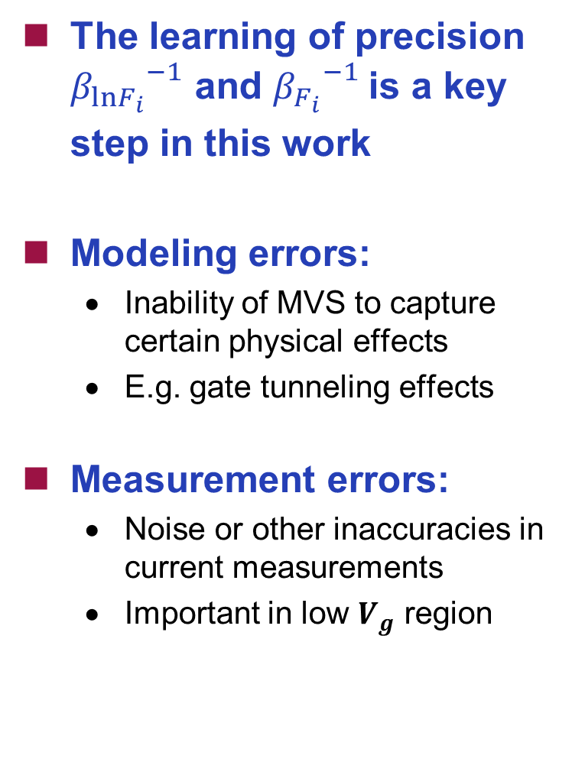

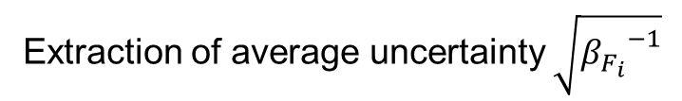
Learning Precision ${β_{F_{i}}}_{}^{−1}$at Different Biases
MVS model error + measurement error
The learning of precision ${β_{lnF_{i}}}_{}^{−1}$ and ${β_{F_{i}}}_{}^{−1}$is a key step in this work
Modeling errors:
  Inability of MVS to capture certain physical effects
  E.g. gate tunneling effects
Measurement errors:
  Noise or other inaccuracies in current measurements
  Important in low $V_{g}$ region
MVS model error
$$σ(\log_{10}I_{d})(A/μm)$$
$$σ(\log_{10}I_{d})(A/μm)$$
$$×{10}^{−5}$$
2
1.5
1
0.5
0
1
0.8
1
$$V_{g}\left(V\right)$$
0.6
0.8
0.6
0.4
0.4
0.2
$$V_{d}\left(V\right)$$
0.2
0
Extraction of average uncertainty $\sqrt{{β_{F_{i}}}_{}^{−1}}$

Slide 23
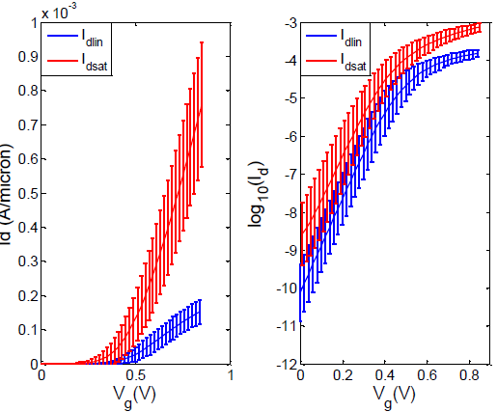
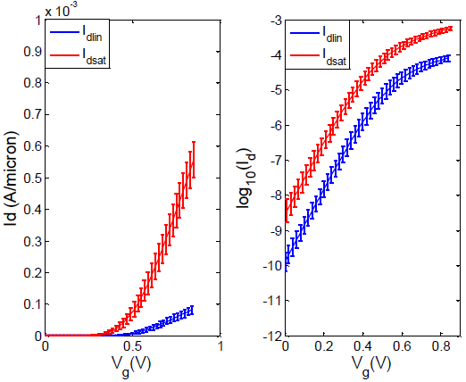

Learning a Prior Distribution
Assuming each current measurement is independent, the likelihood function $pdf\left(F | μ_{P_{sub}},β_{lnF_{i}}\right)$ is
  $pdf\left(F | μ_{P_{sub}},β_{lnF_{i}}\right)=\prod_{i=1}^{n}{pdf\left(F_{i} | μ_{P_{sub}},β_{lnF_{i}}\right)}$
According to Bayes’ rule, we have
  $pdf\left(μ_{P_{sub}} | F\right)∝$ $pdf(μ_{P_{sub}})∙\prod_{i=1}^{n}{pdf\left(F_{i} | μ_{P_{sub}},β_{lnF_{i}}\right)}$
Prior $\left(μ_{s0},Σ_{s0}\right)$ provides information before new measurements about expected transistor I-V curves
Mean and standard deviation of the transistor IV curve learned from historical transistor data (no particular technology information ).
Mean and standard deviation of the transistor IV curve learned from historical transistor data (with particular technology information ).

Slide 24
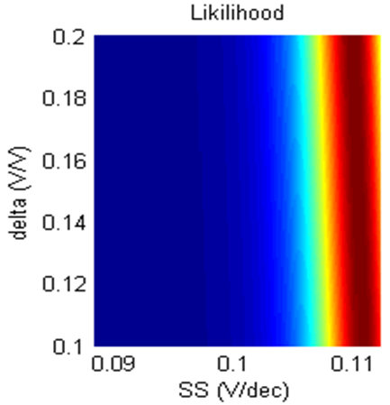
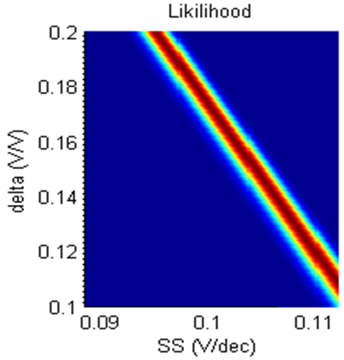
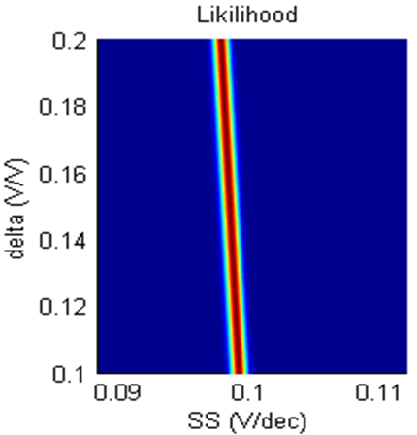
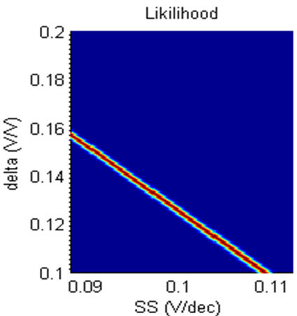
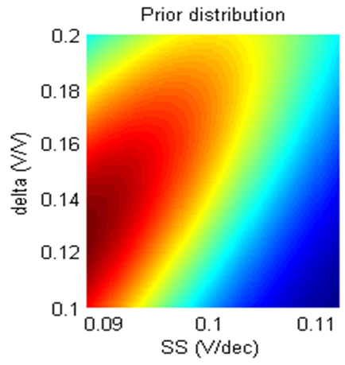
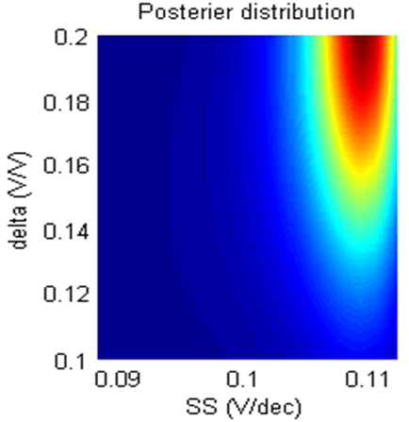
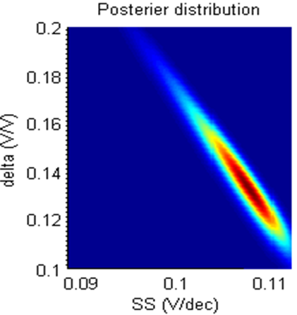
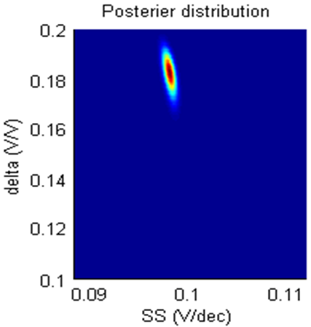
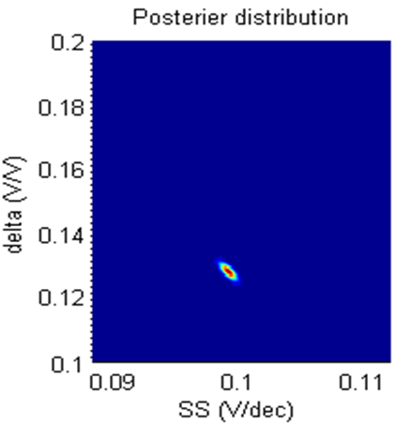
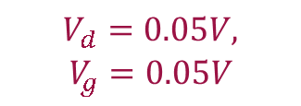


Sequential Bayesian Learning from Prior and
I-V Measurement (sub-threshold parameters: DIBL & SS)
$$V_{d}=0.05V,$$
$$V_{g}=0.05V$$
$$V_{d}=0.9V,$$
$$V_{g}=0.05V$$
$$V_{d}=0.05V,$$
$$V_{g}=0.3V$$
$$V_{d}=0.9V,$$
$$V_{g}=0.3V$$

Slide 25

Maximum a Posteriori Estimation
Goal:$\underset{P_{sub}}{argmax}{pdf\left(μ_{P_{sub}} | F\right)}$ and $\underset{P_{above}}{argmax}{lnpdf\left(μ_{P_{above}} | F\right)}$
Equivalent to minimization with new error function
  $ε\left(P_{sub}\right)=\frac{1}{2}{\left(μ_{P_{sub}}−μ_{s0}\right)}^{T}{Σ_{s0}}^{−1}\left(μ_{P_{sub}}−μ_{s0}\right)+\frac{1}{2}\sum_{i=1}^{n}{β_{lnF_{i}}\left\{ln\left(F_{i}\right)−lnf\left(V_{i},P_{above},P_{sub}\right)\right\}2}$
  $ε\left(P_{above}\right)=\frac{1}{2}{\left(μ_{P_{above}}−μ_{a0}\right)}^{T}{Σ_{a0}}^{−1}(μ_{P_{above}}−μ_{a0})+\frac{1}{2}\sum_{i=1}^{n}{β_{F_{i}}\left\{F_{i}−f\left(V_{i},P_{above},P_{sub}\right)\right\}2}$
Advantages compared to least-square error function:
  Bias-dependent precision:
    allocate weights based on sample measurement errors as contrasted with uniform weights of least-square error function
  An appropriate prior distribution:
    learned from historical transistor data providing parameter probability distribution before new measurements are available

Slide 26




























Example I: Early Technology Evaluation (14nm - 28nm)
Technology 1
Technology 2
$$logI_{d}(A/μm)$$
$$logI_{d}(A/μm)$$
$$I_{d}(A/μm)$$
$$I_{d}(A/μm)$$
$$I_{d}(A/μm)$$
$$I_{d}(A/μm)$$
$$V_{d}\left(V\right)$$
$$V_{g}\left(V\right)$$
$$V_{g}\left(V\right)$$
$$V_{d}\left(V\right)$$
$$V_{g}\left(V\right)$$
$$V_{g}\left(V\right)$$
Technology 3
Technology 4
$$logI_{d}(A/μm)$$
$$logI_{d}(A/μm)$$
$$I_{d}(A/μm)$$
$$I_{d}(A/μm)$$
$$I_{d}(A/μm)$$
$$I_{d}(A/μm)$$
$$V_{d}\left(V\right)$$
$$V_{g}\left(V\right)$$
$$V_{g}\left(V\right)$$
$$V_{d}\left(V\right)$$
$$V_{g}\left(V\right)$$
$$V_{g}\left(V\right)$$

Slide 27






Parameter Consistency with Number of Measurements
$$v_{x0}$$
$$μ$$
  Average extraction error for 50 transistors (variation & noise)
  Baseline: parameters extracted from measurements with 20$mV V_{gs}$ intervals (~100 measurements total)
% error vs. baseline
% error vs. baseline
$$V_{t0}$$
$$δ$$
$$n_{0}$$
% error vs. baseline
% error vs. baseline
% error vs. baseline

Slide 28


Statistical Extraction using Measurement Results (28nm)
 | $$V_{t}$$ | $$δ$$ | $$n0$$ | $$v_{xo}$$ | $$μ$$
$$V_{t}$$ | 1 | -0.104 | 0.363 | 0.339 | 0.328
$$δ$$ | -0.104 | 1 | -0.001 | -0.311 | 0.075
$$n0$$ | 0.363 | -0.001 | 1 | 0.616 | 0.529
$$v_{xo}$$ | 0.339 | -0.311 | 0.616 | 1 | 0.819
$$μ$$ | 0.328 | 0.075 | 0.529 | 0.819 | 1
Allows and captures correlation between MVS model parameters

Slide 29
Outline
Introduction
Foundation
  MIT Virtual Source (MVS) Transistor Model: A Physical Solution
  Statistical MVS Model through Backward Propagation of Variance
Performance Estimation with Very Small Sample Size
  Physical Subspace Projection
  Maximum a Posteriori (MAP) Estimation
Compact Model Parameter Extraction
  Bayesian Inference: Learning Precision and Prior at Different Biases
  Optimal Sampling of Transistor Measurements
Statistical Library Characterization
  Novel Delay/Slew Model
  Exploring Sparsity in Library Input Space
Summary/Acknowledgement

Slide 30






Problem Definition:
Statistical Library Timing Characterization
Supply voltage: $V_{dd}$
  Traditional approach by lookup table with both $μ$ and $σ$ generated from Monte Carlo Simulation
  Interpolation is needed given a group of input combinations
  Recent work explores the sparsity in MC sampling space (process space)
  We propose a novel delay/slew model with four parameters combined with Bayesian inference exploiting sparsity in input vector space
No impact
No impact
Driving strength: $I_{eff}$
Input slew: $S_{in}$
Output load: $C_{load}$
  $t_{d,l−h}=\frac{k_{d}{(V}_{dd}+V′)}{I_{eff,pmos}}(C_{par}+C_{load}+α∙slew)$
  $t_{d,h−l}=\frac{k_{d}{(V}_{dd}+V′)}{I_{eff,nmos}}(C_{par}+C_{load}+α∙slew)$
  $I_{eff,nmos}=\frac{I\left(V_{ds}=\frac{V_{dd}}{2},{ V}_{gs}=V_{dd}\right)+I\left(V_{ds}=V_{dd},{ V}_{gs}=\frac{V_{dd}}{2}\right)}{2}$
  $$=f(V_{th}, delta, SS,v_{xo},mu,…)$$

Slide 31





Model Validation
delay
slew
delay
slew
Tech | Cell | $$k_{d}$$ | $$C_{par}(fF)$$ | $$V′(V)$$ | $$α$$ | error
A | INV | 0.389 | 0.951 | -0.266 | 0.0922 | 1.56%
A | NAND2 | 0.372 | 1.328 | -0.209 | 0.0342 | 1.98%
A | NOR2 | 0.356 | 1.186 | -0.241 | 0.102 | 0.91%
B | INV | 0.416 | 1.046 | -0.287 | 0.1029 | 1.50%
B | NAND2 | 0.403 | 1.471 | -0.228 | 0.0339 | 2.05%
B | NOR2 | 0.374 | 1.276 | -0.253 | 0.1041 | 1.12%
C | INV | 0.389 | 0.978 | -0.272 | 0.1069 | 1.84%
C | NAND2 | 0.383 | 1.120 | -0.258 | 0.050 | 1.94%
C | NOR2 | 0.368 | 1.225 | -0.264 | 0.1170 | 1.47%

Slide 32

Bayesian Inference Characterization Flow

Slide 33



Validation
Validation input spread
Nominal characterization
Statistical characterization
$$μ(T_{d})$$
$$σ(T_{d})$$
17X reduction
20X reduction

Slide 34
Acknowledgments
Funding and support provided in part through the MIT/Masdar Institute Cooperative Program, and in part through collaboration with PDF Solutions, Inc.

